Slide 1
Giorgia Leoncilli, Sara Serafino
Exam: Mathematical Optimization
Analysis and results reproduction of:
Dynamic Wireless Charging Lanes location model in urban networks considering route choices
Cong Quoc Tran, Mehdi Keyvan-Ekbatani, Dong Ngoduy, David Watling
Transportation Research Part C
2022

Slide 2
To determine the optimal location for dynamic wireless charging lanes
To support the system planner in deploying the WCL, the paper takes into consideration traffic dynamics and congestion under multiple vehicle classes.
The problem combines a mixed-integer linear program with dynamic routing behaviour into the charging location problem.
The objective is to maximise network performance while providing insights into traffic propagation patterns over the network.

Slide 3
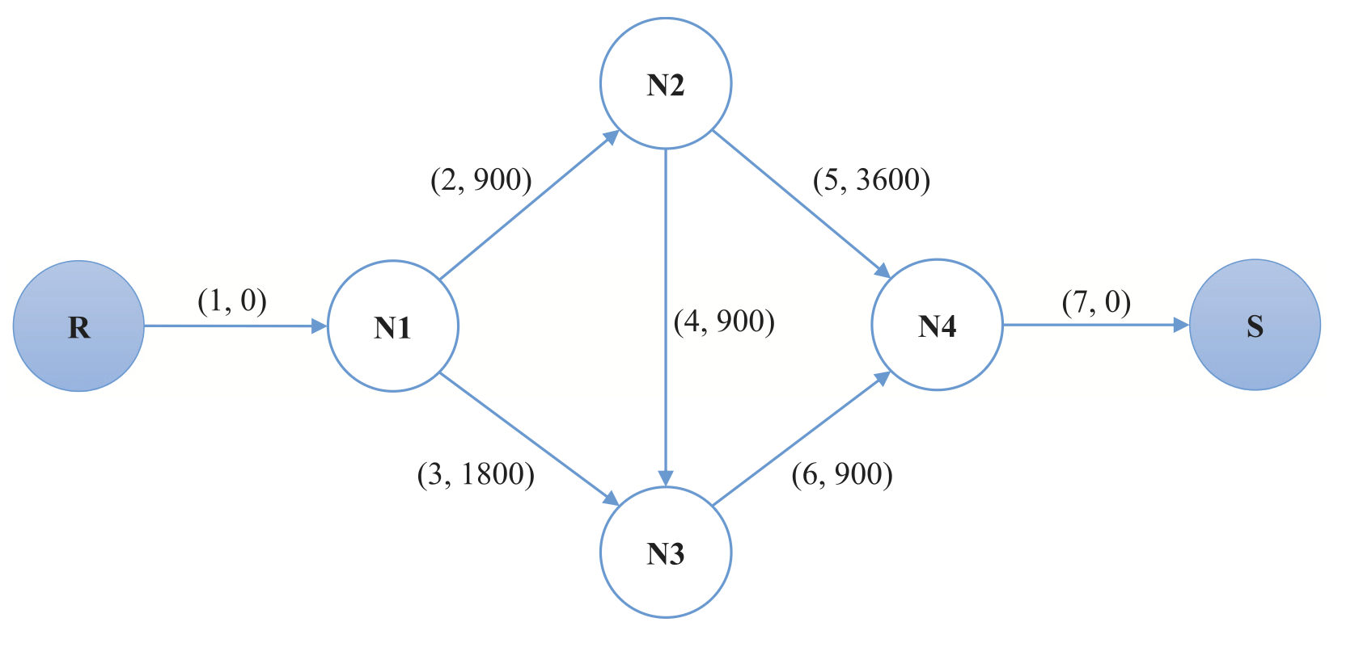
Network design problem → limited to single Origin-Destination networks
Upper level: minimise the system cost with specific demands
Lower level: Traffic Assignment Problem

Slide 4
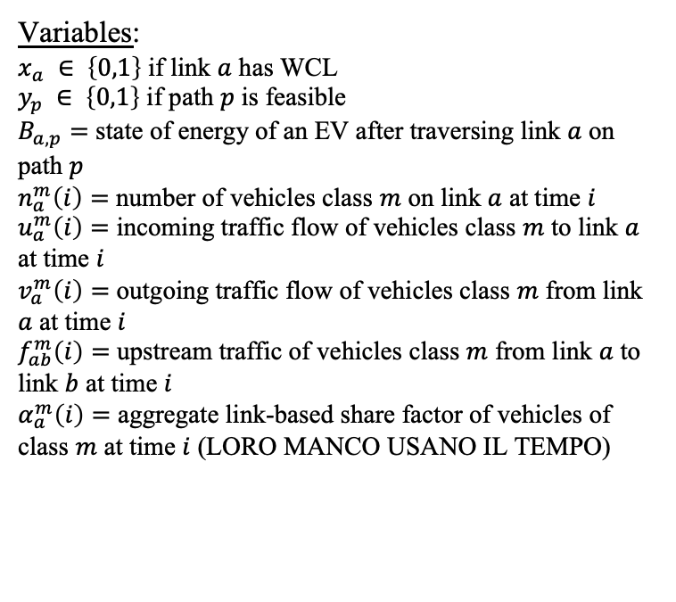
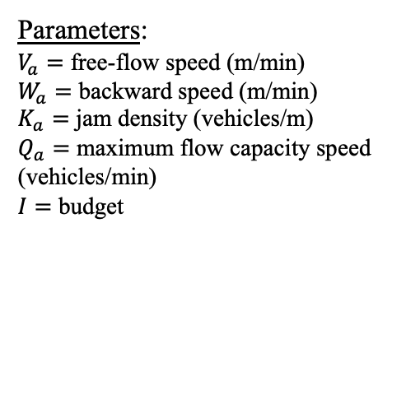
General formulation
Variables:
$x_{a} ∈ \left\{0,1\right\}$ if link $a$ has WCL
$y_{p} ∈ \left\{0,1\right\}$ if path $p$ is feasible
$B_{a,p}=$ state of energy of an EV after traversing link $a$ on path $p$
$n_{a}^{m}\left(i\right)=$ number of vehicles class $m$ on link $a$ at time $i$
$u_{a}^{m}\left(i\right)=$ incoming traffic flow of vehicles class $m$ to link $a$ at time $i$
$v_{a}^{m}\left(i\right)=$ outgoing traffic flow of vehicles class $m$ from link $a$ at time $i$
$f_{ab}^{m}\left(i\right)=$ upstream traffic of vehicles class $m$ from link $a$ to link $b$ at time $i$
$α_{a}^{m}\left(i\right)=$ aggregate link-based share factor of vehicles of class $m$ at time $i$ (LORO MANCO USANO IL TEMPO)
Parameters:
$V_{a}=$ free-flow speed (m/min)
$W_{a}=$ backward speed (m/min)
$K_{a}=$ jam density (vehicles/m)
$Q_{a}=$ maximum flow capacity speed (vehicles/min)
$I=$ budget

Slide 5
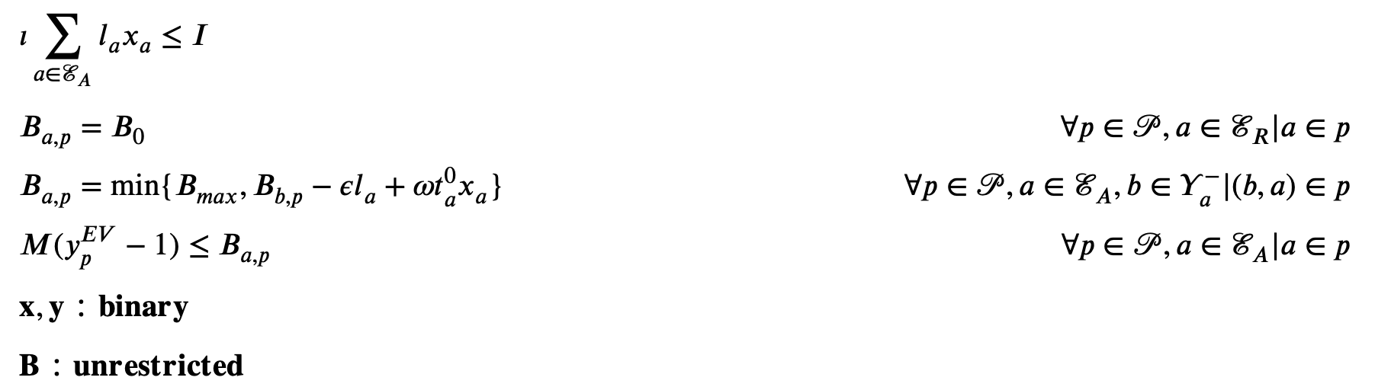
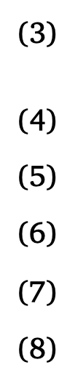
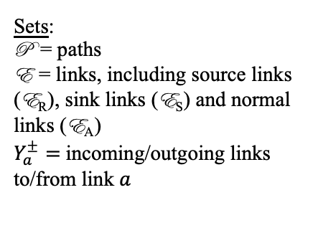
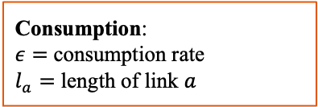
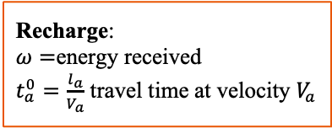
Constraints
Recharge:
$ω=$energy received
$t_{a}^{0}=\frac{l_{a}}{V_{a}}$ travel time at velocity $V_{a}$
Consumption:
$ε=$ consumption rate
$l_{a}=$ length of link $a$
budget
initial state of energy
path feasibility
Sets:
P = paths
E = links, including source links (E_{R}), sink links (E_{S}) and normal links (E_{A})
$Y_{a}^{±}=$incoming/outgoing links to/from link $a$

Slide 6
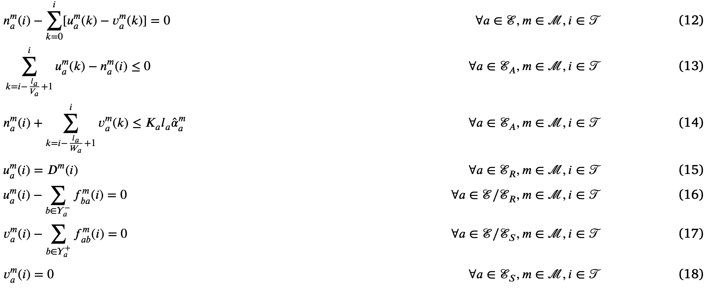
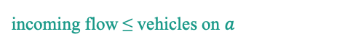
Constraints
vehicles conservation
incoming flow ≤ vehicles on $a$
capacity per class
demand for incoming vehicles at origin
}
flow conservation
network cleared at destination

Slide 7

Constraints
vehicles conservation
incoming flow ≤ vehicles on $a$
Extra constraints:
SCRIVILE QUANDO LE AVRAI
capacity per class
demand for incoming vehicles at origin
}
flow conservation
network cleared at destination

Slide 8
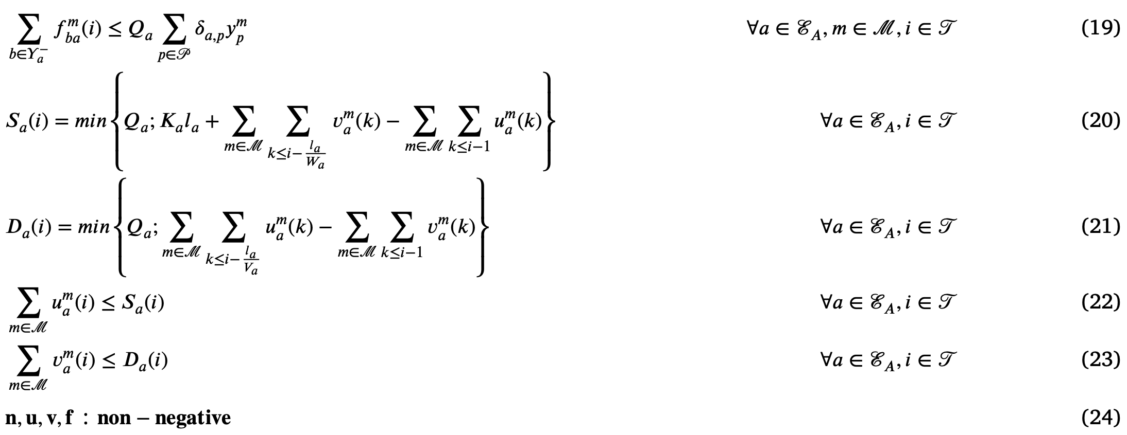
Constraints
different route choices
supply
demand
}
true capacity

Slide 9
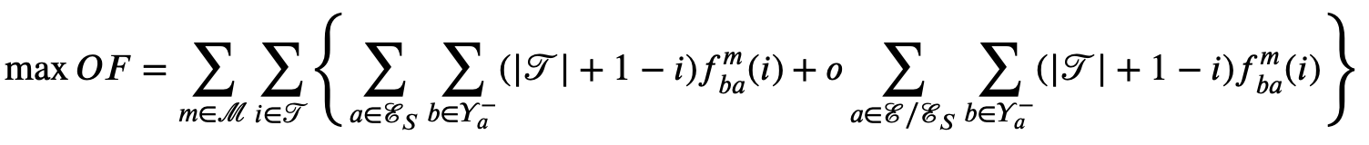
Objective function
Set of discrete time steps
Penalty cost to incentivise travellers to move along instead of waiting
Maximising total traffic outflow is mathematically equivalent to minimising total travel times.

Slide 10
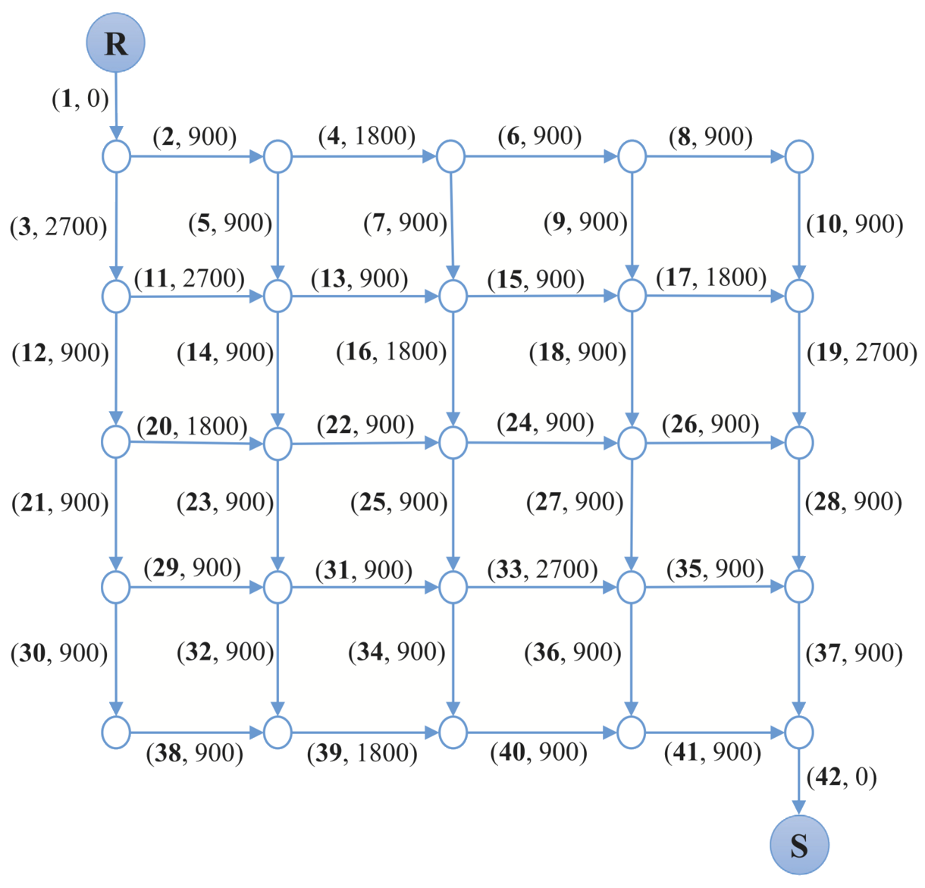
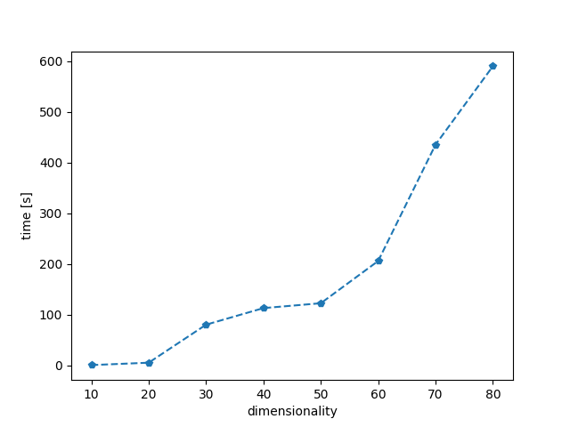
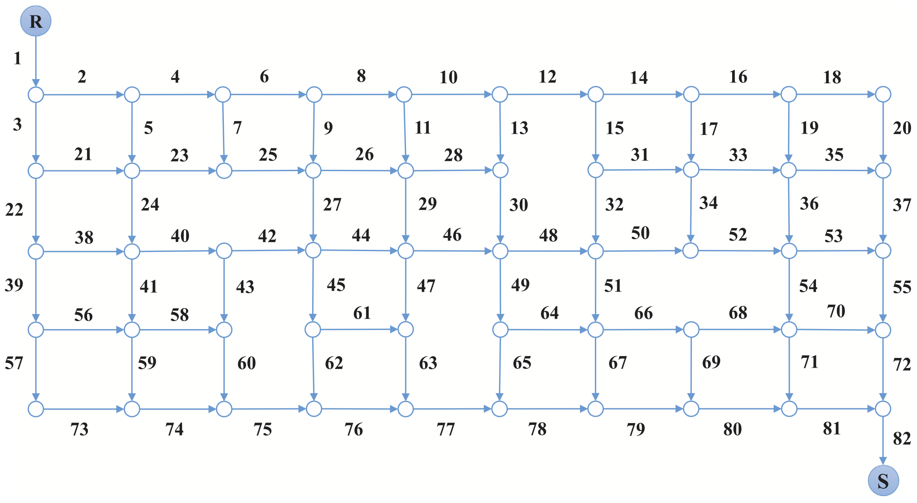
Gurobi optimization: increasing dimensionality
Boosting the dimensionality of the problem, the time of execution highly increases.
Dimensionality increases

Slide 11
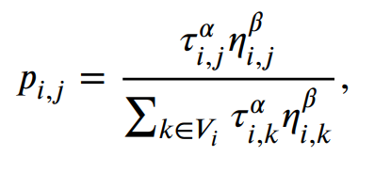
Generation of a feasible path
The choice of the path by an ant is done according to a probabilistic model that assigns to each “feasible next node” a probability.
Those probabilities are computed in following way:
5
4
2
3
End
Current
chosen parameters
4
2
set of “feasible next nodes”
5
The set of “feasible next nodes” is obtained including all the nodes that have not been already touched in the previous steps of the path, and such that the sum of the “remaining time” and the time taken to reach those nodes, plus the time needed to go from them to the final node, satisfies the T_max constraint.
6
7

Slide 12
Example:
Considering:
T_max = 15
T_current = 8
the “feasible next nodes” for the current position are the ones colored in green:
8 + 2 + 3 = 13 < 15 = T_max
8 + 5 + 2 = 15 = 15 = T_max
while the other two are left out because:
8 + 5 + 4 = 17 > 15 = T_max
8 + 6 + 7 = 21 > 15 = T_max
5
4
2
3
End
Current
4
2
5
6
7

Slide 13
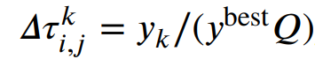
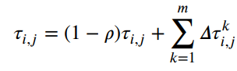
Two different implementations: AS and MMAS
Ant System
Δτ computation
Each ant computes its own Δτ matrix.
Those are then summed together to obtain the final Δτ matrix, used to update the τ-matrix in the following way:
final Δτ matrix
“pheromone evaporation coefficient”

Slide 14
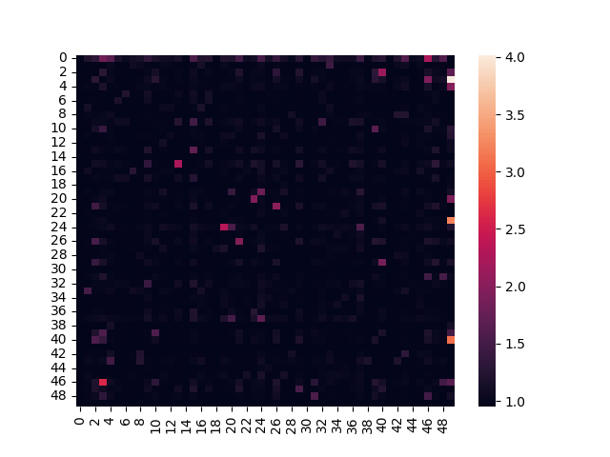
Two different implementations: AS and MMAS
Ant System
Main characteristics of AS algorithm:
inevitable increase of the distance between the τ[i, j] elements correspondent to the edges included in the best solution found so far and the ones not included in it, which could easily lead to convergence to a local optimum (which could be in general not the global one)
general slowness due to the large amount of ants included in the population: at each iteration, the greater the number of ants, the higher the probabilities to take the right path for the global optimum (which will be hardly modified in the next iterations owing to the inevitable increase of τ-elements distance)

Slide 15
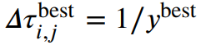
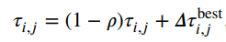
Two different implementations: AS and MMAS
Min-Max Ant System
Δτ computation
Only the “best ant” computes its own Δτ matrix.
This concept can be implemented in two ways:
best ant: ant that found the best path in the current iteration → iteration best
best ant: ant that found the best path until the current iteration → global best
Then, the best ant’s Δτ matrix is used to update the τ matrix in the same way:

Slide 16
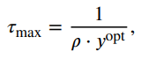
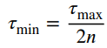
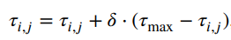
Two different implementations: AS and MMAS
Min-Max Ant System
Two extra differences are to be noted between MMAS and AS implementations. In particular, they consist in:
control over the maximum and the minimum value of τ[i, j] such that:
an additional mechanism called “pheromone trail smoothing” to deal with premature convergence:
0 ≤ 𝛿 ≤ 1 is a control parameter

Slide 17
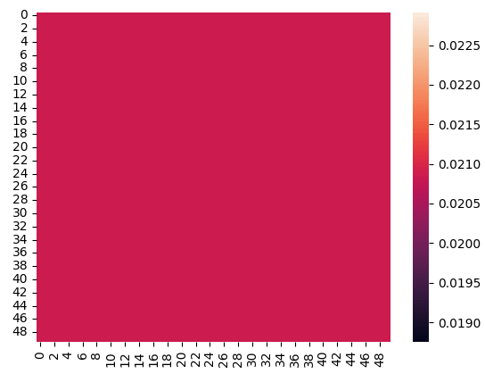
Two different implementations: AS and MMAS
Min-Max Ant System
Main characteristics of MMAS algorithm:
distance between the τ[i, j] elements kept under control (plus tail smoothing mechanism), that allow to possibly not get stuck in a local maximum
faster than AS,owing to the minor number of ants included in the population and to the fact that the τ-matrix is updated by one ant (the best one) at a time

Slide 18
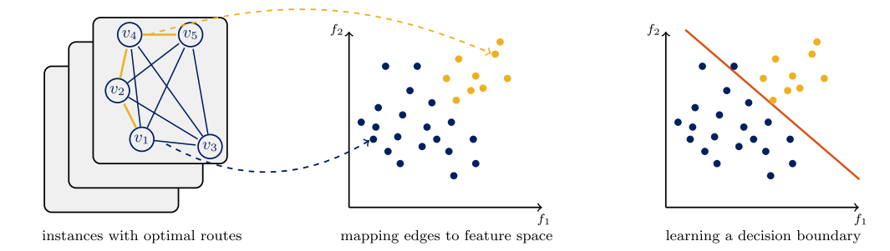
ML - Ant Colony Optimization
The idea is to incorporate the probability values predicted by the trained ML model into the ACO algorithm, i.e., using the probability values to set the heuristic weight matrix or to initialize the pheromone matrix of ACO.
The aim is to bias the sampling of ACO towards favoring the edges that are predicted more likely to be part of an optimal route, and hopefully to improve the efficiency of ACO in finding high-quality routes.

Slide 19
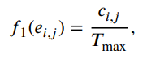
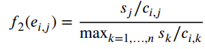
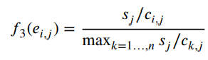
Features’ extraction
Three factors are relevant to the objective, i.e., vertex scores 𝑆, edge costs 𝐶 and time budget 𝑇_max.
Three graph features are then defined:
it computes the relative payoff of selecting edge 𝑒[𝑖, 𝑗], comparing to the alternative ways of leaving vertex 𝑣[i]
It computes the relative payoff of visiting vertex 𝑣[𝑗] via edge 𝑒[𝑖, 𝑗], comparing against other ways of visiting vertex 𝑣[j]
Intuitively, if 𝑐[𝑖, 𝑗] > 𝑇max, the edge 𝑒[𝑖, 𝑗] certainly cannot appear in any of the feasible solutions

Slide 20
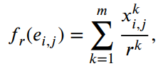
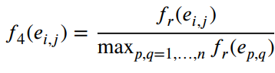
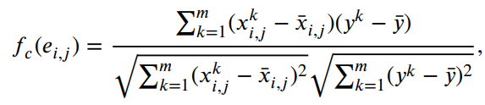
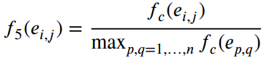
Features’ extraction
The graph features are computationally very cheap, but they only capture local characteristics of an edge.
Hence, we also adopt two statistical measures:

Slide 21
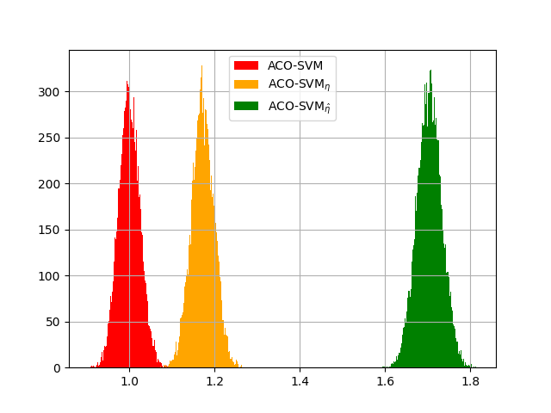
Analysis of results: ACO-SVM
This graphic is obtained using the initial probabilistic models to sample 10,000 solutions for each test problem instance, and plotting the distribution of averaged normalized objective values.
The objective values of the sample solutions are normalized by the mean objective value generated by the classic ACO algorithm. The normalized objective values are then averaged across 100 test problem instances.
AS and MMAS distinguish is in this case irrelevant because we refer only to the initial probability model.

Slide 22
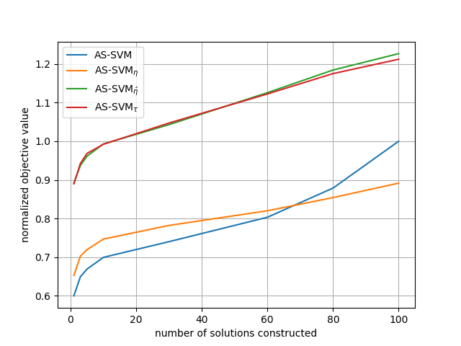
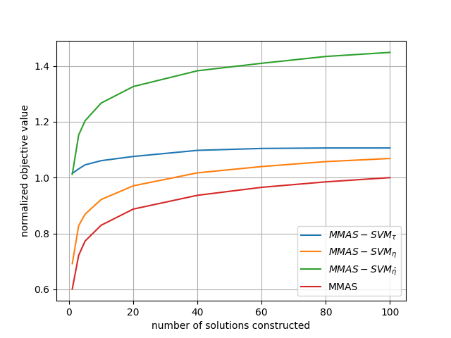
Analysis of results: ACO-SVM
40% improving with the second ML-MMAS algorithm
The objective values generated by each ML-algorithm varying the number of solutions generated are normalized by the best objective value found by classic AS (or MMAS), and are averaged across 100 problem instances and 15 independent runs.
The curves of normalized objective value v.s. number of solutions constructed is shown for both AS and MMAS methods
20% improving

Slide 23
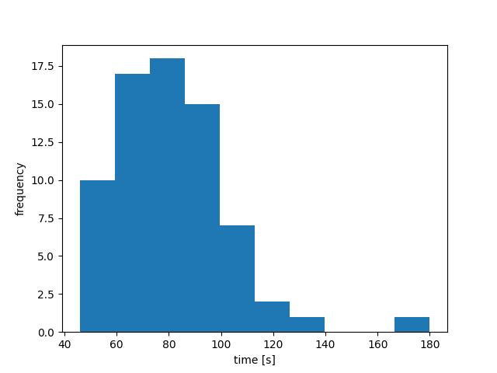
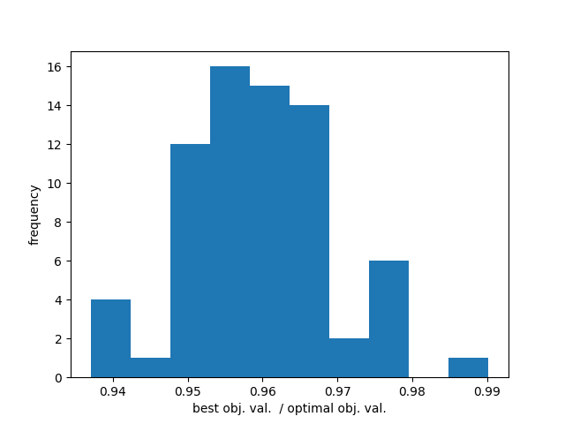
Analysis of results: ACO-SVM
Testing the MMAS-SVM method on 71 problems of dimensionality equal to 100.
The time-taken analysis could be extremely improved adding elements of parallel programming to the implementation.

Slide 24
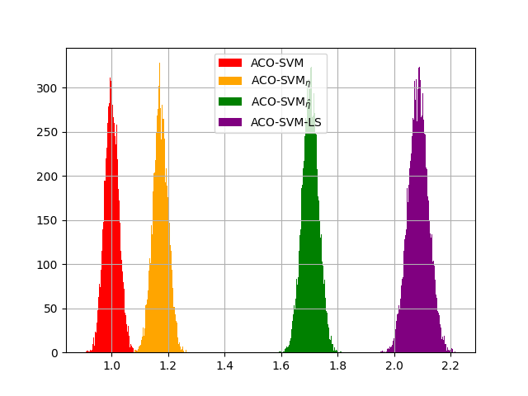
Analysis of results: ACO-SVM-LS
Same histograms obtained by computing 10,000 solutions for each test problem instance, and plotting the distribution of averaged normalized objective values.

Slide 25
Thank you for the attention

